Slide 1
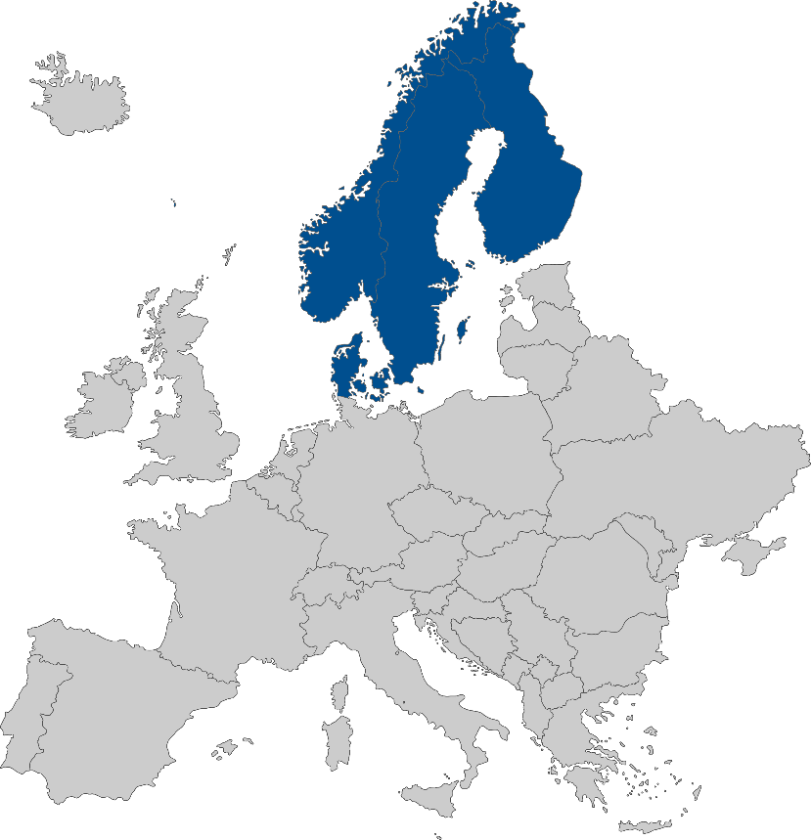
Nordic Payments Council (NPC)
Stakeholder Forum
Meeting no. 21, 26 March 2026
In Stockholm and via Teams

Slide 2
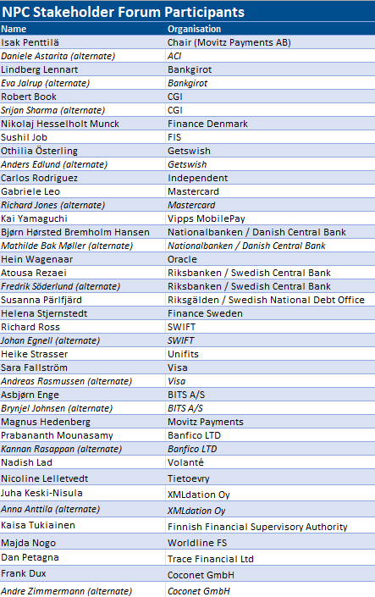
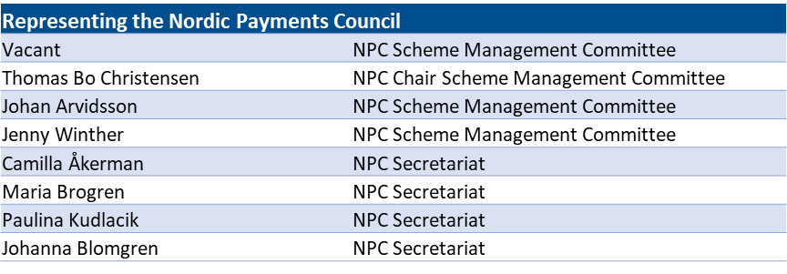

Slide 3

Suggested Agenda
Introduction
Approval of Agenda
Approval of last meeting’s minutes
Appointment of minutes adjuster
NPC General information
Nordic community update - NO
External speaker
Nordic community update – SE and DK
Break
NPC Verification of Payee
NPC Payment Schemes
Position papers
NPC going forward
Any other business
Closing

Slide 4
Suggested Agenda
Introduction
Approval of Agenda
Approval of last meeting’s minutes
Appointment of minutes adjuster
NPC General information
Nordic community update - NO
External speaker
Nordic community update – SE and DK
Break
NPC Verification of Payee
NPC Payment Schemes
Position papers
NPC going forward
Any other business
Closing

Slide 5
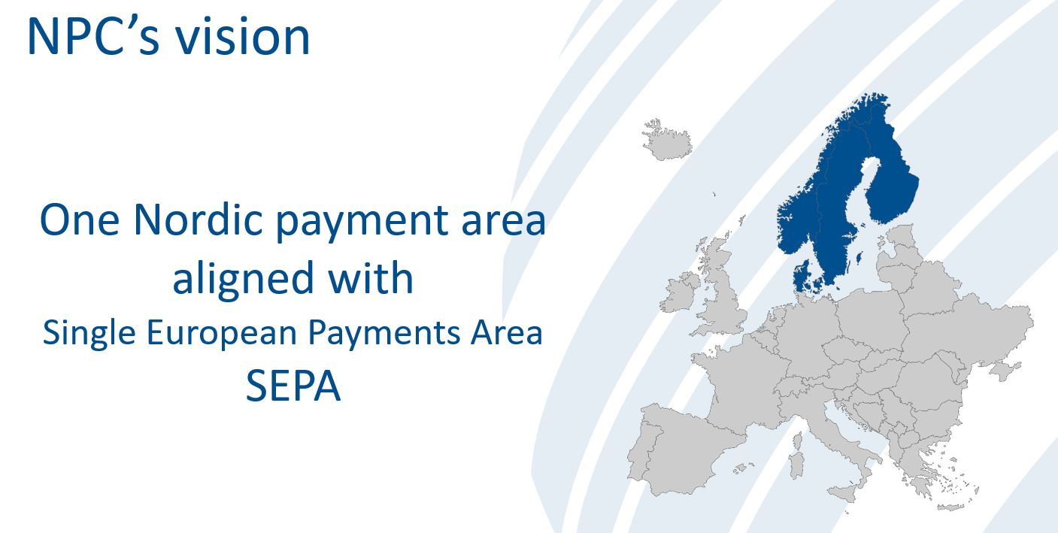
NPC Vision and Strategy 2026-2029
NPC Strategy 2026–2029 – Key Priorities
Full rollout of NCT and NCT Inst across all scheme currencies by 2029
Launch of NPC Verification of Payee to strengthen compliance and fraud prevention
Launch of NPC One‑Leg Out Instant Credit Transfer to support cross‑border payments
High‑quality operation and maintenance of existing schemes, aligned with SEPA and Nordic needs
Strong member engagement and collaboration with Clearing and Settlement Mechanisms (CSMs), Routing and/or Verification Mechanisms (RVMs), and stakeholders
Enhanced anti‑fraud capabilities across all NPC schemes
Outcome: Positioning NPC as a leader in Nordic payment harmonisation, delivering a secure, efficient, and interoperable payment ecosystem.

Slide 6
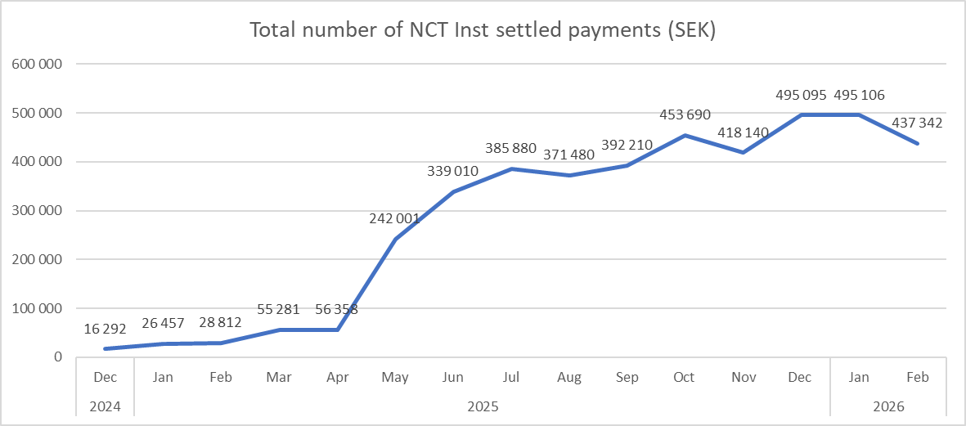
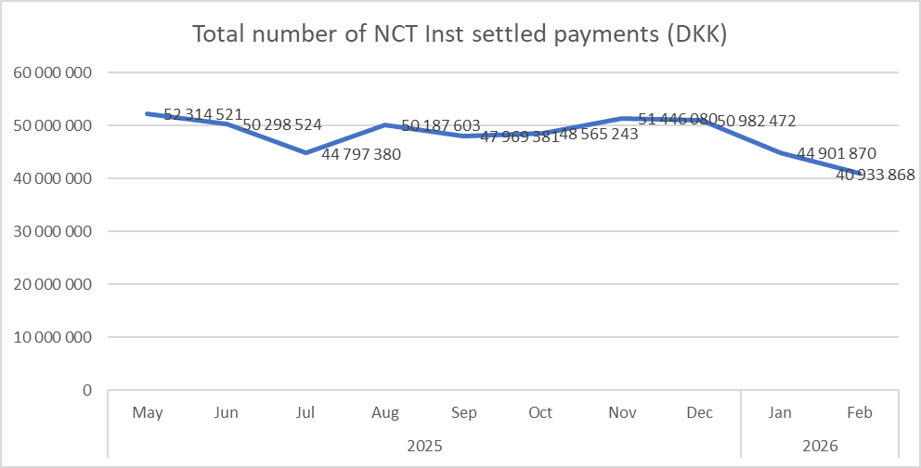
Information from the NPC
Membership Status and Scheme Involvement
New Scheme Member approvals: Trade Republic Bank GmbH Filial Sweden, Saxo Bank A/S, PPRO Payment Services S.A., and Stripe Technology Europe Ltd. In total 85 NPC Scheme Members
Please Note: Swish transactions not included

Slide 7
Suggested Agenda
Introduction
Approval of Agenda
Approval of last meeting’s minutes
Appointment of minutes adjuster
NPC General information
Nordic community update - NO
External speaker
Nordic community update – SE and DK
Break
NPC Verification of Payee
NPC Payment Schemes
Position papers
NPC going forward
Any other business
Closing

Slide 8
Norway community update
Brynjel Johnsen, Head of department, Bits
NPC Stakeholder Forum 26 March 2026

Slide 9




Project status March 2026
Norway community update
Project
Description
Status
Implementing a joint VOP solution in Norway
RFP process on-going. Production earliest q2 27
Verification of payee (VOP)
Bits takes ownership of registers important for the payments infrastructure
Migration q1 26 for register1. Planning on-going for register2.
BRUS registry infrastructure
Future clearing
(FA30+)
Analyse and evaluate alternatives for the future NOK clearing infrastructure.
Concept phase on-going.
New solution for real time payments (from NICS Real til NBO INST/TIPS)
Re-planning Norges Bank. Migration earliest q4 28
NBO INST (TIPS)

Slide 10
Project under consideration
Norway community update
Project
Description
Status
Later end-of day securities settlement in Norges Bank. Require later end of day NICS Clearing
Impact assessment on-going. In production q3-q4 27
Sec. Settlement t+1

Slide 11
Suggested Agenda
Introduction
Approval of Agenda
Approval of last meeting’s minutes
Appointment of minutes adjuster
NPC General information
Nordic community update - NO
External speaker
Nordic community update – SE and DK
Break
NPC Verification of Payee
NPC Payment Schemes
Position papers
NPC going forward
Any other business
Closing

Slide 12
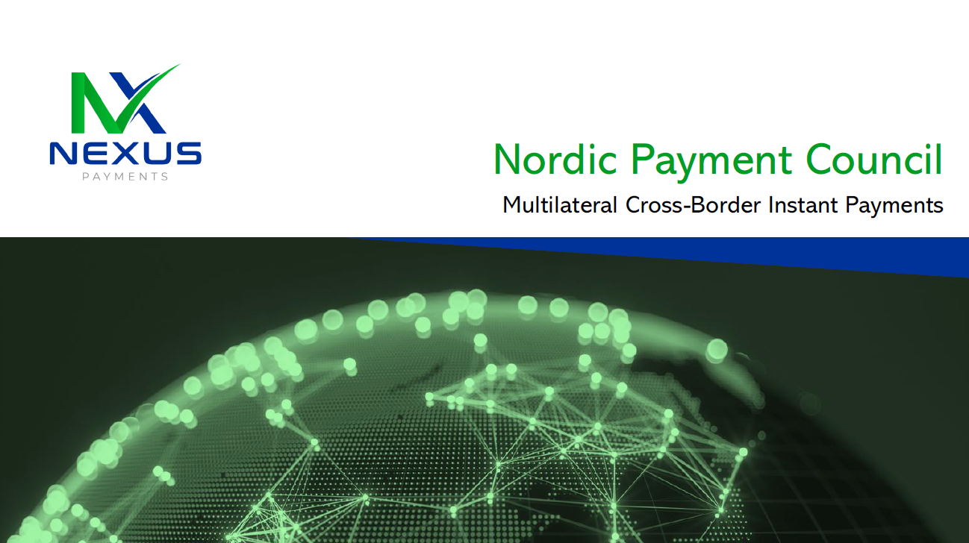
External Speaker: Nexus
Presentation from Mark Munne,
CTO at Nexus Global Payments

Slide 13
Suggested Agenda
Introduction
Approval of Agenda
Approval of last meeting’s minutes
Appointment of minutes adjuster
NPC General information
Nordic community update - NO
External speaker
Nordic community update – SE and DK
Break
NPC Verification of Payee
NPC Payment Schemes
Position papers
NPC going forward
Any other business
Closing

Slide 14
Helena Stjernstedt
Finansiell infrastruktur /Svenska Bankföreningen (Finance Sweden)/BSAB
26th of March, 2026

Slide 15
In preparation of a new Swedish payment infrastructure….
Bankgirot continues with the preparation for the upcoming transformation from the existing payment infrastructure (Dataclearingen (DCL) and the Bankgiro system) to Bankgirot's new payment infrastructure which will be based on NPC’s schemes and the format standard ISO20022.
  Transition of Payments:
    During 2026, all Bankgirot payments (except direct debit) will gradually move to SEK Batch.
    Direct debit (Autogiro) will transition later, between 2027–2029.
End–date for Dataclearingen: 30th of June 2026, in accordance with the transformation plan. Bankföreningen in the role of owner, informed the participants during the summer (30th of June).
Finance Sweden (Svenska Bankföreningen) supports the initiative and coordinates/contributes to, a multiple of activities:
  The Program Office (PMO) is staffed by Lars-Åke Edenfeldt, who is responsible for running various activities related to the transformation such as coordinating issues and being responsible for certain joint communication to the market, e.g. to ERP suppliers and to Service agents and charity association.
  The Swedish Transformation Program, now more of a function, is co-chaired by Finance Sweden and Bankgirot.
  Coordinating questions with our members and Bankgirot that arises from the work with the transformation plan

Slide 16
Central bank initiatives and time plans – The Riksbank
2026/2027/2030
Preparation for future settlement services continues (T2/T2S):
    T2 Feasibility Assessment phase ongoing
      T2 contract negotiation with ECB, formal signing planned for October 2026
    T2 Go-live February 2030
    T2S lower activity than T2, in agreement with decision “T2 prior to T2S”.
TIPS Cross Currency
  Terms and conditions (T&C´s):
    RIX participants consulted spring 2026
    June 2026 enter into force (bilateral agreements until than)
  November 2026 planned date for impmentation of NPC OLO Scheme RIX-INST
  Testing (continues) during 2026 - 2027
Potential future initiatives:
E-krona

Slide 17

Questions?
Please contact: helena.stjernstedt@financesweden.se
Additional information – please visit our webpage: https://www.bankinfrastruktur.se
Note: BSAB is a subsidiary to Finance Sweden

Slide 18
NPC Stakeholder Forum
26 March 2026

Slide 19
Updates from the Danish market
Update on the modernisation of the Danish payment infrastructure
STEP2DKK
VoP

Slide 20
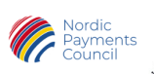
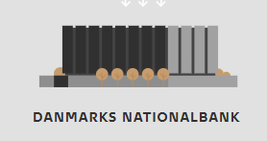
Future Payments Infrastructure
The overall purpose of the project is to modernize and harmonize the payment infrastructure in Denmark. The project's objectives include, among other things:
TIPS DKK instant payments (completed at Easter 2025)
Implementation and transition to instant payments via TIPS DKK at Easter 2025
TIPS DKK follows NPC formats
STEP2 DKK batch payments, expected from early Q2 2027
Implementation and transition to the STEP2 DKK clearing, including migration to NPC formats
Migration of transactions from Intraday Clearing to STEP2 DKK expected in Q2 2027, followed by decommissioning of the Intraday Clearing.
Closure of the Dokumentløs Clearing (Document‑less Clearing), expected during 2028
Migration of products in the Document‑less Clearing via STEP2 DKK (FI card, GI card)
Further information to follow.
CONSUMERS
CREDIT CARD
DEBIT CARD
CREDIT TRANSFER
MOBILE
SUM
-CLEARING
One business day
STEP2 DKK
CLEARING
Same day
TIPS DKK
CLEARING
Instantly
Notes:
Info meetings together with the NPC concerning the NCT scheme on-boarding.
Concerning technical changes in relation to the STEP2 DKK transition:
Information meeting aimed at ERP vendors took place 4 February 2026.
FI and GI cards: common payment slips and Giro slip. Implementation is planned for expected Q2 2028 – exact timing will be communicated in Q2 2026.

Slide 21
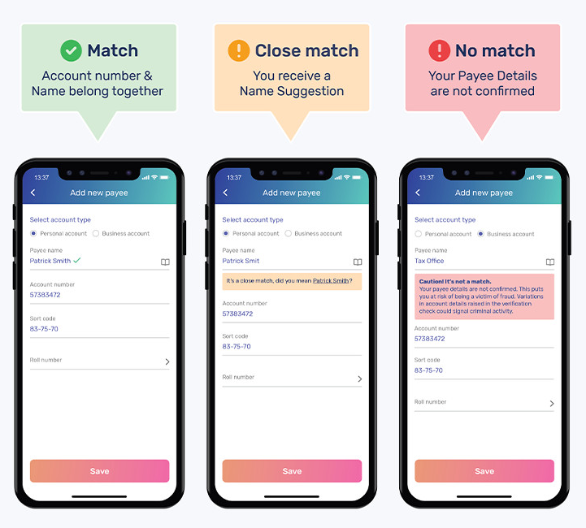
Verification of Payee
VoP – Verification of Payee
​
Background
VoP will become mandatory for EUR payments (SEPA) from July 2027 for all non-eurozone countries in EU, e.g. DK
The VoP requirements since October 2025 have included instant credit transfers in EUR between banks within the Eurozone – but not instant credit transfers to/from banks outside the Eurozone.
DK timeline
Everyone can respond, early January 2027
Usage in customer channels until July 2027
Notes:
It may be added that the final rules for non‑euro in relation to VOP are pending the forthcoming PSR (Payment Service Regulation), which is expected to be finalised in July this year.

Slide 22
Questions?
Nikolaj Hesselholt Munck
nhm@fida.dk
(+45)29692801

Slide 23
Suggested Agenda
Introduction
Approval of Agenda
Approval of last meeting’s minutes
Appointment of minutes adjuster
NPC General information
Nordic community update - NO
External speaker
Nordic community update – SE and DK
Break
NPC Verification of Payee
NPC Payment Schemes
Position papers
NPC going forward
Any other business
Closing

Slide 24
Suggested Agenda
Introduction
Approval of Agenda
Approval of last meeting’s minutes
Appointment of minutes adjuster
NPC General information
Nordic community update - NO
External speaker
Nordic community update – SE and DK
Break
NPC Verification of Payee
NPC Payment Schemes
Position papers
NPC going forward
Any other business
Closing

Slide 25
NPC Verification of Payee
Old NPC CoP 2024 v1.0 was archived due to changed market circumstances. NPC PSPs decided to take Nordic transformation support out of scope of the NPC rulebook and focus on compliance requirements only (PSR art. 50 & 57) within a new scheme – the NPC Verification of Payee.
Based on EPC VOP → a Nordic copy of an EPC scheme (NPC standard/payment schemes way of working).
  Functionality: aim to facilitate legal requirements and alignment with the eurozone
  Legal context: fit for the Nordics being non-euro EU countries, affected by the PSR

Slide 26
The future NPC Verification of Payee
Facts:
Based on the EPC Verification of Payee, aim to stay in sync (Standard NPC Way of Working)
  Operational and business layer of the NVOP internal draft hasn’t so far made any deviations from the EPC VOP
  NPC VOP v1.0 will likely be published already in sync with EPC VOP v1.1 (publ. March 2026) & 2.0 (publ. Nov 2026)
Compliance focus (Payment Services Regulation, especially art. 50 & 57)
API-based, no ISO Implementation Guidelines
Non-binding guidance on name matching
NPC negotiating the use of EPC Directory Service for reachability and interoperability (not finalised).
Moving target – legal review & publication:
Publication & In-effect dates – dependent on the publication of the PSR .
  Public Consultation of the NVOP draft est. Q1 2027 (Stakeholder Forum position paper Q2 2027)
  Publication & In-effect est. mid-2027
→ Aim to publish NPC VOP at least 6+ months ahead of regulatory deadlines to allow for timely adherence.

Slide 27
Suggested Agenda
Introduction
Approval of Agenda
Approval of last meeting’s minutes
Appointment of minutes adjuster
NPC General information
Nordic community update - NO
External speaker
Nordic community update – SE and DK
Break
NPC Verification of Payee
NPC Payment Schemes
Position papers
NPC going forward
Any other business
Closing

Slide 28
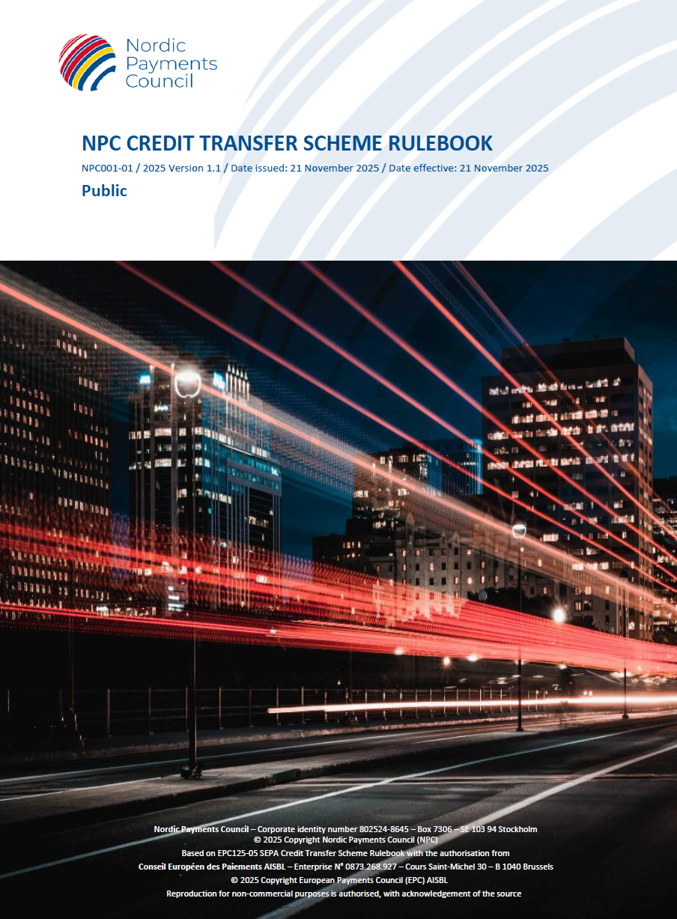

NCT & NCT Inst schemes
Change request public consultation for 2027 versions start March 15th end June 3rd
NPC021-02 NCT and NCT Inst Rulebook 2027 Public Con Change Requests
NPC021-04 NCT and NCT Inst Rulebook Response template 2027 CM
Zip file with NPC Internal and External change requests
EPC change requests is to be found on EPCs website after March 13th
nordicpaymentscouncil.org/get-involved/public-consultations-2027-npc-payment-schemes/
NPC encourage all to take part in the public consultation!

Slide 29
Change management cycle 2027 version of NCT & NCT Inst
Milestone overview | Milestone overview
 | Date | Description
 | Jun 10th, 2025 | SMC decision to start Call for change request August 15th
 | Aug 15th, 2025 | Start Call for change request, ongoing between August 15th and December 15th
 | Aug - Feb 2026 | NCT & NCT Inst WG prepare and agree on suggested CRs (Internal, External, EPC)
 | Oct – Feb 2026 | Legal Support Group first review of change request that need legal support (if needed)
 | Dec 15th, 2025 | Submission deadline for 2027 CRs
 | Jan – Feb 2026 | NCT & NCT Inst WG formulation of recommendations for each CR
 | February 2026 | SMC decision to start Public Consultation (March 15th, 2026, until June 3^{rd,} 2026) on all suggested CRs
 | Mar 15th, 2026 | Start of 90 days Public Consultation on 2026 CRs until 3rd June 2026
 | Mar - Sep 2026 | NPC Stakeholder Forum: presentation and discussion for 2027 CRs to prepare for position paper
 | Jun – Oct 2026 | NCT & NCT Inst WG review of Public consultation comments and preparing final CRs and Rulebook 2027 version
 | Sep – Oct 2026 | NCT & NCT Inst WG finalization of Change Proposal Submission Documents
 | Sep 2026 | NPC Stakeholder Forum: formal position on 2027 Change requests for NCT & NCT Inst scheme Rulebooks
 | Oct 2026 | NCT & NCT Inst WG finalization of proposed 2027 Rulebooks
 | Aug – Oct 2026 | Legal Support Group review final updated 2027 Rulebooks
 | Nov 2026 | SMC meeting: final decision on each CR, Change proposal Submission documents and approval of 2027 Rulebook publications
 | Nov 2026 | Publication of 2027 NCT & NCT Inst Scheme Rulebooks
 | Nov 2027 (14th or 21st) | Entry into force of 2027 NCT & NCT Inst Scheme Rulebooks
* final 2027 date will be aligned with the final Swift Standards MX Release 2027 date

Slide 30
Summary of change requests
4 Internal CRs – brought forward by NCT & NCT Inst WG
2 Internal CRs – will be part of the “PSR package” (CRs related to PSR requirements)
1 Internal CR - brought forward from NPC Secretariat
  3 External CRs – sent in from the Nordic payment market
  Approx 14 EPC CRs relevant for NPC schemes (both Internal and External)
  Uncertainty about EPC “PSR CRs” – NPC’s “PSR package”
  EPC is currently assessing how to handle “PSR CRs” – most probably there will be a separate publication for these

Slide 31
NPC Internal and External change requests (NCT & NCT Inst)
EPC Id | NPC Id | Name | NCT | NCT Inst | NPC Status | EPC status
N/A | #01 | NCT_NCT Inst-NPC UETR new attribute number | X | X | NPC Internal – Supported for 2027 | EPC CR #03 2027 – Neutral (no recommendation)
N/A | #02 | NCT Inst-NPC-NPC Planned period of non-availability in NCT Inst |  | X | NPC Internal – Supported for 2027 | Implemented 2025 in SCT Inst
TBD | #03 | NCT_NCT Inst-NPC-Freeze and Reserve Funds Recall due to Fraud Suspicious transactions (PSR article 65 and 69) | X | X | NPC Internal – Withdrawn for 2027 PSR implementation TBD | EPC Internal - Withdrawn for 2027 PSR implementation TBD
TBD | #04 | NCT_NCT Inst-NPC-Provision of commercial trade name Suspicious transactions (PSR article 16 and 25) | X | X | NPC Internal - Withdrawn for 2027 PSR implementation TBD | EPC Internal - Withdrawn for 2027 PSR implementation TBD
#25 | #05 | NCT_NCT Inst-NPC-Partial refund – Recall due to Fraud | X | X | NPC Internal - Supported for 2027 | EPC CR #25 2027 – Neutral PSR related (no recommendation)
N/A | #06 | NCT_NCT Inst-NPC-Changes to Structured Remittance Information, underlying elements | X | X | NPC Internal – Supported for 2027 | N/A
N/A | #07 | NCT_NCT Inst-NPC- Chief compliance officer to sign Legal opinion |  |  | NPC Internal – Supported for 2027 | N/A
#17 | #08 (#15) | NCT_NCT Inst-FIDA-Funds Transfer Regulation Org Id | X | X | NPC External – Supported for 2027 | EPC CR #17 supported for 2027
N/A | #09 | NCT_NCT Inst –Riksgälden-Customer to PSP Implementation Guidelines mandatory | X | X | NPC External – Not supported for 2027 | N/A
N/A | #10 | NCT_NCT Inst-FIDA-Message type | X | X | NPC External - Supported for 2027 | Implemented 2025 SCT and SCT Inst
Notes:
#06 – Changes made in pacs.008 to be aligned with pain.001 under Structured Remittance information and present more in the pdf
#07 – Sign the Legal opinion can also be a Cheif complinace office – don’t have to be an external legal councel
#09 – Earlier decision ”no legal requirements in the Nordics as in SEPA, SEPA Regulation” and could conflict with the principle of proportional access to payment systems and could create a risk of excluding potential participants that currently participate in national domestic clearing when migrating to the NPC schemes. These circumstances to have changed and market progress remains slow, still no readiness.
#10 – Allowing a short name for Original Message Name Identification “pacs.008” (pacs.008.001.08)

Slide 32
EPC Internal and External change requests (SCT & SCT Inst)
EPC Id | NPC Id | Name | NCT | NCT Inst | EPC Status | NPC status
#06 | #11 | All schemes-EPC-Migration to a newer ISO 20022 version for the 2029 rulebooks | X | X | EPC Internal - Supported for 2027 → 2029 | Supported for 2027 → 2029
#07 | #12 | All schemes-EPC-Amendments to rulebook stipulations on Additional Optional Services (AOSs) | X | X | EPC External – Supported for 2027 | Supported for 2027
#08 | #13 | All schemes-EPC-Consistent Use of Term Payment Account | X | X | EPC External – Supported for 2027 | Supported for 2027
#10 | #14 | SCT Inst-EPC-Beneficiary Initiated Repayment |  | X | EPC Internal – Supported for 2027 (asking PC for input) | Supported for 2027
#17 | #15 (#08) | All schemes-EPC-Changes to (Ultimate) Creditor-Debtor Organization and Private Identification | X | X | EPC External – Supported for 2027 | Supported for 2027
#18 | #16 | All schemes-EPC-Changes to Structured Remittance Information | X | X | EPC External – Supported for 2027 | Supported for 2027
#19 | #17 | SCT schemes-CH and LI PSP community-Include Address for Originator -and Beneficiary Ref. Parties | X | X | EPC External – No recommendation for 2027 | NPC following EPC – No recommendation for 2027
#21 | #18 | SCT schemes and OCT Inst-CH and LI PSP community-Validate Structured Remittance Information | X | X | EPC External – Supported for 2027 | The change is already provided for in the NCT & NCT Inst scheme: no action
Notes:
#06 – ISO newer verison migration – latest available ISO 20022 version at that future point in time – may lead to that the CM is happening eariler to give the market more time for the implantation.
#07 – EPC Oversight recommendations to more proactive role in ensuring compliance of scheme participants. Area of attention – AOS – extra paragraphs in Rulebook – very much like how NPC already work today with AOS.
#10 - Merchant-Beneficiary initiated “repayment” feature under the SCT Inst scheme being similar to what is known under e.g., the payment card schemes (Spain do it already with AOS and can make a return of funds without the Originator having to initiate first an SCT Inst Recall or a Request for Recall by the Originator (RFRO) request. This “Repayment procedure – allowing the beneficiary to return funds”. Not only for SCT POI but for all SCT Inst. Pacs.008 vs pacs.004?

Slide 33
EPC Internal and External change requests (SCT & SCT Inst)
EPC Id | NPC Id | Name | NCT | NCT Inst | EPC Status | NPC status
#22 | #19 | All schemes-SK PSP community-Align Effectiveness Dates with Those of Relevant Technical Standards | X | X | EPC External – Support for 2027 | Supported for 2027
#25 | #20 | SCT schemes-ES PSP community-Procedure for Partial Recovery of Funds for Fraudulent Transfers | X | X | EPC External – No recommendation for 2027. Probably for PSR | Supported for 2027 (see NPC CR #05)
#27 | #21 | SCT schemes and OCT Inst-PT PSP community- Possibility to Return Funds after Credit of Amount | X | X | EPC External – SCT no recommendation for 2027 SCT Inst no support for 2027 | NPC following EPC NCT - no recommendation NCT Inst – not supported
#35 | #22 | SCT schemes-IT PSP community-Extend Recall Timeline for Duplicate and Technical Reason | X | X | EPC External – Supported for 2027 | Supported for 2027
#42 | #23 | SCT Inst-EPI-Reference to Link an SCT Inst Transaction for Refund with Initial SCT Inst Transaction |  | X | EPC External - Supported for 2027 | Supported for 2027
#45 | #24 | SCT Inst-EPI-No Need for POI Indicator in SCT Inst Transactions |  | X | EPC External – No support 2027 No change to Rulebook | No support for 2027
TBD | #03 | Impact PSR article 65 and 69 - Suspicious transactions (Freeze and Reserve Funds) | TBD | TBD | No formal CR for 2027 - Regulatory CM cycle TBD | Open for 2027 “PSR package” – TBD
TBD | #04 | Impact PSR article 16 and 25 - Suspicious transactions (Provision of commercial trade name) | TBD | TBD | No formal CR for 2027 - Regulatory CM cycle TBD | Open for 2027 “PSR package” – TBD
Next PSEMWG meeting 2026-02-18
Notes:
#22 – Effectivness date – to be aligned with SWIFT standards, November ECB releases
#27 – Possibility for the Beneficiary to return a SCT Inst transaction after the amount is credited, allowing the use of the Return R-transaction reason “return by order of the Beneficiary” – using pacs.004.
#35 – Recall procedure is 10 BBD for DUPL and TECH and 13 mouth for FRAD. Need more time for e.g., bulk payments. 13 to much, 15 BBD is instead suggested.
#42 - Introduction of a reference in Beneficiary/Merchant-initiated payments (used for refunds or chargebacks) to link the SCT Inst transaction of that refund or chargeback to the original SCT Inst transaction. By introducing a reference ID in the SCT Inst message linked to a refund or a chargeback, this will help the PSPs in linking this SCT Inst transaction to the original SCT Inst transaction.
#45 – Indicator in SCT Inst to indicate if the transaction is related to POI (yes/no). EPC: Purpose code or category purpose can already be used to indicate that.

Slide 34

NOLO Inst scheme
Rulebook finalized and out on public consultation between March 15th and June 11th
NPC040-01 NPC One Leg Out Instant Credit Transfer Rulebook draft 0.99
NPC046-01 NPC NOLO Inst Response template - public consultation on the NOLO Inst Rulebook
Background to the development of the NOLO Inst Rulebook and its relation to the EPC OCT Inst Rulebook
nordicpaymentscouncil.org/npc-schemes/npc-one-leg-out-instant-credit-transfer-scheme/
NPC encourage all to take part in the public consultation!

Slide 35
Milestone plan NPC NOLO Inst Scheme Rulebook
Milestone plan
 | Date | Description
 | Feb 17th, 2025 | SMC decision to start developing an NPC “NOLO Inst” Scheme
 | Mar 2025 → Feb 2026 | OLO Task Force developing Rulebook
 | May 2025 → Jun 2026 | NPC TF IG (with support from OLO TF) developing Implementation Guidelines
 | Sep 2025 → Feb 2026 | Legal support group support on specific legal questions from the review of NOLO Inst Rulebook
 | Feb 2026 → Jun 2026 | Internal review by NCT & NCT Inst WG on NOLO Inst Rulebook
 | Feb 2026 | SMC decision to start Public Consultation (Mar 15th 2026 until Jun 11th 2026) on draft NPC NOLO Inst Scheme Rulebook
 | Mar 15th 2026 → Jun 11th 2026 | Start of 90 days Public Consultation on first version of NPC NOLO Inst Scheme Rulebook until June 11th, 2026
 | Mar 2026 | NPC Stakeholder Forum: presentation and discussion NOLO Inst to prepare for position paper
 | Apr 2026 → Sep 2026 | OLO TF review outcome of the Public consultation
 | Jun 2026 → Oct 2026 | OLO TF making updates and adjustments based on comments from the market in public consultation and preparing the final version of the NPC NOLO Inst Scheme Rulebook
 | Oct 2026 | NPC Stakeholder Forum: formal position on NOLO Inst Scheme Rulebook
 | Sep 2026 → Oct 2026 | Legal Support Group review final version of NOLO Inst Scheme Rulebook
 | Nov 2026 | SMC meeting: final decision and approval to publish version 1.0 of NOLO Inst Scheme Rulebook
 | Nov 2026 | Publication of NPC NOLO Inst Scheme Rulebook 2026 version
 | Nov 2026 | Entry into force of NPC NOLO Inst Scheme Rulebook 2026 version

Slide 36
Time plan - NOLO Inst scheme
2025
2026
2027
NPC General
Plan
February 2025:
SMC and Board decision to start development
June 2025:
SMC decision
in-effect date for “NOLO Inst” Scheme
Q2-Q3 2026:
Stakeholder Forum position paper for “NOLO Inst” Scheme
November 2026:
SMC decision to
publish and in-effect “NOLO Inst” Scheme
TBD 2027:
SMC decision to publish version 2027 of NOLO Inst Scheme
November 2027:
EPC OCT Inst v.2027
in-effect
November 2027:
NOLO Inst v.2027
in-effect
Phase 1: NPC OLO Task Force develop ”NOLO” Inst scheme Q2-Q4 2025
November 2026:
EPC OCT Inst v.2027
Published
Private consultation/review on NOLO Inst Rulebook by NCT & NCT Inst WG
Phase 2: public consultation Q2 2026
In parallel: Follow EPC OCT Inst CM 2027
Phase 3: preparing final version Q3 2026
Phase 4: preparing NOLO Inst 2027 version
NPC TF IG
High level
plan
Phase 1:
NPC internal work
Phase 2:
TF IG work with IGs
October 2026:
OLO TF to agree on final IG drafts before SMC decision
Phase 3: Private consultation NCT & NCT Inst WG
Ongoing status report to OLO TF

Slide 37
Suggested Agenda
Introduction
Approval of Agenda
Approval of last meeting’s minutes
Appointment of minutes adjuster
NPC General information
Nordic community update - NO
External speaker
Nordic community update – SE and DK
Break
NPC Verification of Payee
NPC Payment Schemes
Position papers
NPC going forward
Any other business
Closing

Slide 38
Purpose position paper
The Stakeholder Forum serves as the platform where end-users and suppliers can express their needs and viewpoints, ensuring they are included in the decision process for rulebook development.
The Forum gathers and consolidates comments and views from market participants into a single, unified position document “the position paper”
The completed position paper is sent to the SMC, which must take the Forum’s views into account when evaluating Change Requests and Change Proposals for inclusion to the NCT & NCT Inst schemes version 2027.

Slide 39
NPC Stakeholder Forum Timeline 2026 - Position papers
Jan | Feb | Mar | Apr | May | Jun | Jul | Aug | Sep | Oct | Nov | Dec
NPC SMC
19/2
14/4
11/6
22/9
19/11
SHF
26/3
23/6
17/9
10/11
Public consultations ends;
NCT & NCT Inst June 3rd
NOLO Inst June 11th
22/9 SMC decision on 2025 CRs for NCT & NCT Inst
19/11 SMC decision to publish NCT & NCT Inst 2027 version and NOLO Inst 2026 version
SHF assigns task force members to participate in the drafting of position paper for the changes in NCT & NCT Inst rulebooks and for the NOLO Inst
SHF has reached an agreement on the position papers
SHF TF is drafting 1 position paper on the changes related to NCT and NCT Inst
SHF TF is drafting a position for the NOLO Inst scheme
Q1/Q2 ‘27:
SHF TF is drafting a position for the NVOP scheme
SHF meetings
SMC Meeting

Slide 40
Suggested approach position papers
Meeting March 26 SHF discuss and agree on initial approach for position papers
  NCT & NCT Inst change requests for 2027
  NOLO Inst scheme Rulebook 2026
  Suggestion to set up 2 task forces, one for each position paper
  Tack force 1 – NCT & NCT Inst 2027 change requests
  Task force 2 – NOLO Inst Rulebook
  Can start the work by going through CRs and Rulebook
Meeting June 23 – discussion and information after input from public consultation
  Task forces to send out first version of position paper
Meeting Sep 17 – SHF to agree on final version of position paper

Slide 41
Call to action
The position paper work will span over approx. 5 months and is important to give the SMC the stakeholder perspective.
Estimated time allocation to participate in a task force is: 10 hours
Estimated time allocation to lead a task force is: 12 hours
Please send a note to Isak Penttilä if you wish to participate in Task Force 1 and/or Task Force 2 by 2026-04-09.
Indicate in the note if you are willing to lead the task force.

Slide 42
Suggested Agenda
Introduction
Approval of Agenda
Approval of last meeting’s minutes
Appointment of minutes adjuster
NPC General information
Nordic community update - NO
External speaker
Nordic community update – SE and DK
Break
NPC Verification of Payee
NPC Payment Schemes
Position papers
NPC going forward
Any other business
Closing

Slide 43
Workplan and Meetings
Stakeholder Forum meetings 2026
26 March, 13:00-16:00 (Stockholm & Teams)
  Kick-off position papers
23 June, 13:00-15:30
  First draft of position papers ready to discuss
17 September, 13:00-15:30
  Approval of position papers
10 November, 13:00-15:30
  TBD
Task Forces Position Papers:
Changes to NCT and NCT Inst (2027)
NOLO Inst (2026)

Slide 44
Suggested Agenda
Introduction
Approval of Agenda
Approval of last meeting’s minutes
Appointment of minutes adjuster
NPC General information
Nordic community update - NO
External speaker
Nordic community update – SE and DK
Break
NPC Verification of Payee
NPC Payment Schemes
Position papers
NPC going forward
Any other business
Closing

Slide 45
Suggested Agenda
Introduction
Approval of Agenda
Approval of last meeting’s minutes
Appointment of minutes adjuster
NPC General information
Nordic community update - NO
External speaker
Nordic community update – SE and DK
Break
NPC Verification of Payee
NPC Payment Schemes
Position papers
NPC going forward
Any other business
Closing

Slide 46
More information:
Web: www.nordicpaymentscouncil.org
E-mail: info@npcouncil.org
The NPC Secretariat
Secretary General: Camilla Åkerman camilla.akerman@npcouncil.org
Scheme Manager NCT & NCT Inst: Maria Brogren maria.brogren@npcouncil.org
Payment Specialist: Johanna Blomgren johanna.blomgren@npcouncil.org
Scheme Manager NPC VOP: Paulina Kudlacik paulina.kudlacik@npcouncil.org

Slide 47
NPC Organisation
General Assembly
Founding Members – representatives in the Board and in working groups. Assisting the NPC with local expertise.
Nominating Committee
NPC Board
Denmark
Finance Denmark
CSM Forum
Secretariat
Incl. Compliance & Adherence
Finland
Finance Finland
Stakeholder Forum
Scheme Management Committee
Sweden
Finance Sweden
Norway
Bits
Legal Support Group
Risk Management Support Group
NCT & NCT Inst
Working Group
NVOP
Working Group

